Slide 1
MGT388 Finance and Law for Engineers
Marginal costing and short term decision making

Slide 2
Lecture Outline
Relevant costs for decision making in the short term
Fixed and variable costs
Contribution
Short tem decisions Accept or reject orders
Closing a product line
Make or buy decisions

Slide 3
Relevant costs for decision making
Relevant costs and revenues are those costs and revenues that will differ for each option available to the decision maker.
Sunk costs = past costs.
As these have already been incurred they are irrelevant to a decision.
Future costs and revenues that change under the different options are relevant costs.

Slide 4
Relevant costs for decision making
Variable costs are relevant
These costs vary in direct proportion with volume of activity.
Cost
Variable cost
10,000
1,000
                500 5,000 Output

Slide 5
Relevant costs for decision making
Fixed costs are not relevant
These costs remain constant over wide ranges of activity.
cost
4,000 Fixed cost
Output
In the long run all costs are variable.

Slide 6
Relevant costs for decision making
Opportunity costs are relevant
This is the value of the benefit sacrificed when one course of action is chosen in preference to an alternative.

Slide 7
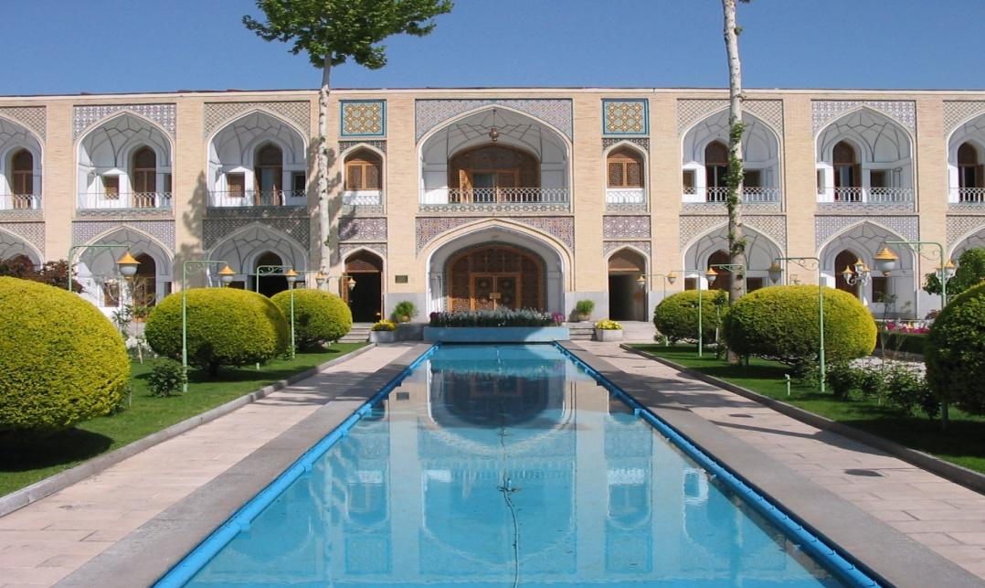
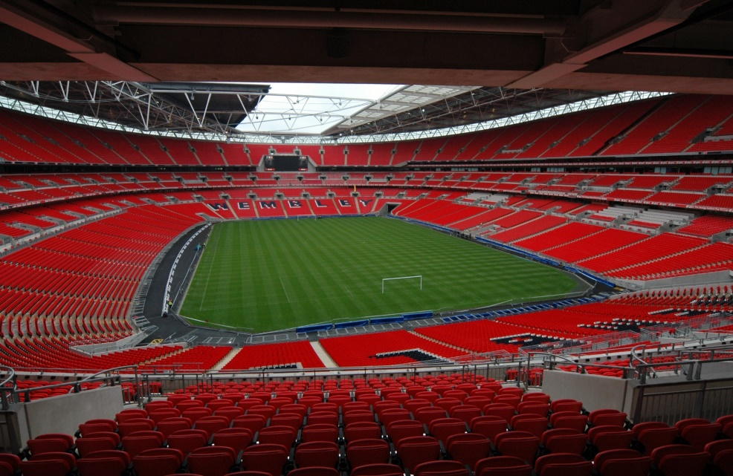
Hotel V Football Stadium
A consortium wishes to build a football stadium. The land could have been used for other purpose. Of the other alternatives the most profitable would be a hotel complex.
In considering the construction of the stadium the future costs and revenues would be analysed as well as the opportunity cost (the profit) of not building a hotel.

Slide 8
Marginal costing for decision making
Marginal cost is the cost of one additional unit of a good or service. The cost of an additional unit is the cost that change.
Variable costs are the costs that change and so are considered in marginal costing.
Fixed costs do not change if just one extra unit is produced so they are not considered in marginal costing.

Slide 9
Marginal costing for decision Making
Contribution only considers the costs and revenues that will change.
Contribution = sales price – variable costs
In the short term a project will be accepted if it makes a positive contribution.
That is it contributes to fixed costs and profit of a business.
Profit = Sales Revenue– variable costs– fixed cost Profit = Contribution – fixed costs

Slide 10

Accept Or Reject an Order
Firelight Ltd

Slide 11
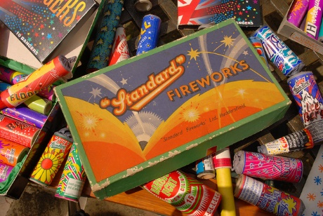
Acceptance/ Rejection of an order
Firelight Ltd manufactures boxes of fireworks. Each box of fireworks sells for £120.
Variable cost per box is £35.
Fixed overheads amounts to £60,000.
1,000 boxes of fireworks are produced but there is capacity to produce 1,300 boxes.
Firelight Ltd receives an order for to supply 200 boxes of fireworks for £40.
Should Firelight Ltd accept the order?

Slide 12
Acceptance/ Rejection of an order
Profit Prior to The Order
Sales Revenue (£120 x1,000) 120,000
Less
Variable costs (£35 x 1,000) (35,000)
Fixed costs (60,000)
Profit 25,000

Slide 13
Acceptance/ Rejection of an order
Using marginal costing the order will be accepted if the contribution is positive.
Sales value – variable cost = contribution
£40- £35 = £5
Therefore the order should be accepted

Slide 14
Acceptance/ Rejection of an order
To confirm this is the correct decision the profit can be re-calculated after the order
By accepting the order an extra £1,000 profit is generated. (200 boxes x £5 contribution)
 | Original Profit | Additional Profit | New Profit
Sales Revenue (£120 x1,000) (£40 x 200) | 120,000 | 8,000 | 128,000
Less
Variable costs (£35 x 1,000) (£35 x 200) | (35,000) | (7,000) | (42,000)
Fixed costs | (60,000) |  | (60,000)
Profit | 25,000 | 1,000 | 26,000

Slide 15
Acceptance/ Rejection of an order
Would the correct decision been made using product costing/Absorption costing?
Variable costs are £35
Fixed costs are £60,000 and if we accepted the order units of production 1,200 boxes.
Under absorption costing each box would be apportioned £60,000/1,200 = £50
The total cost of £85 (£35 +£50) would be compared to a sales price.

Slide 16
Acceptance/ Rejection of an order
As the sales price is £40 the order would not be accepted, and profits would be forgone.
It is correct to ignore fixed costs in short term decision making.
If there had been an alternative use for the spare capacity then the opportunity cost should be included.
Other factors need to be considered such as having to offer sale price to current customers.

Slide 17
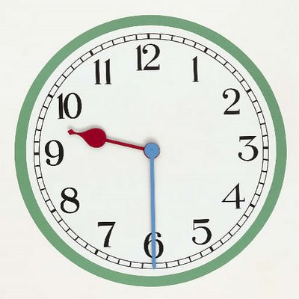
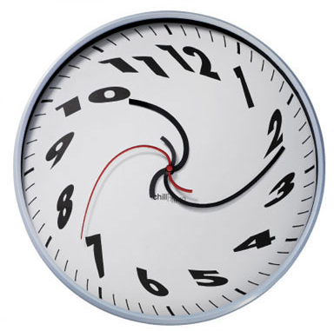
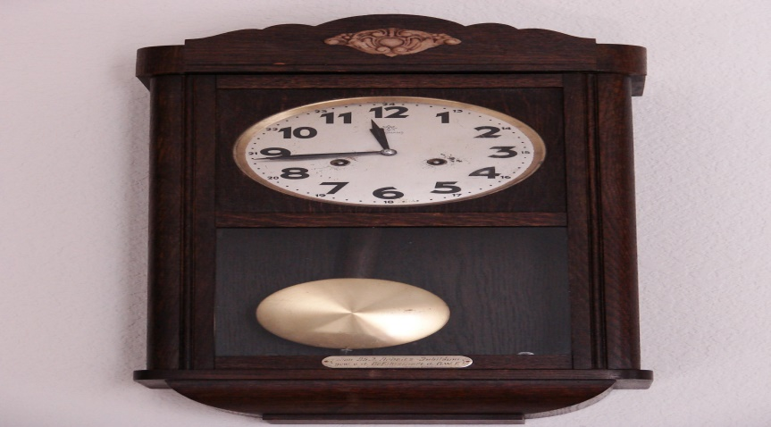
Discontinue production
Time Ltd

Slide 18
Discontinue Production
Time Ltd manufactures 3 styles of wall clock, classic , contemporary and modern.
For the current period 9,000 of each style of clock is produced.
Fixed costs of £435,000 are apportioned equally to each product line.
It appears that the contemporary range are loss making and Time Limited plans to discontinue production.
State whether this decision is correct if:
(a) No alternative use for the facilities used in making the contemporary clocks
(b) The facilities could be used to make a further 4,000 modern clocks.

Slide 19
Discontinue Production
 | Classic £ | Contemporary £ | Modern £ | Total £
Sales value | 50 | 55 | 80
Variable cost | (20) | (40) | (45)
Contribution Per unit | 30 | 15 | 35
No. of units | 9,000 | 9,000 | 9,000
Total contribution | 270,000 | 135,000 | 315,000 | 720,000
Fixed costs | (145,000) | (145,000) | (145,000) | (435,000)
Profit/(loss) | 125,000 | (10,000) | 170,000 | 285,000

Slide 20
Discontinue Production
Profits with contemporary clocks being produced is £285,000.
If production of contemporary clocks are discontinued the fixed costs will still be £435,000 but now just split between the classic clocks and modern costs.

Slide 21
Discontinue Production
 | Classic £ | Contemporary £ | Modern £ | Total £
Total contribution | 270,000 | 135,000 | 315,000 | 720,000
Fixed costs | (145,000) | (145,000) | (145,000) | (435,000)
Profit/(loss) | 125,000 | (10,000) | 170,000 | 285,000
 | Classic £ | Contemporary £ | Modern £ | Total £
Total contribution | 270,000 | 135,000 | 315,000 | 720,000
Fixed costs | (145,000) | (145,000) | (145,000) | (435,000)
Profit/(loss) | 125,000 | (10,000) | 170,000 | 285,000
 | Classic £ | Contemporary £ | Modern £ | Total £
Total contribution | 270,000 | 0 | 315,000 | 585,000
Fixed costs | (217,500) | (0) | (217,500) | (435,000)
Profit/(loss) | 52,500 | 0 | 97,500 | 150,000

Slide 22
Discontinue Production
If no other use can be made of the facilities Time Limited should continue production of contemporary clocks.
Contemporary clocks had made a positive contribution of £135,000 to fixed costs and profits.
Total profits with contemporary clocks £285,000, total profits without contemporary clocks £150,000.

Slide 23
Discontinue Production
However if facilities can be used to produce 4,000 extra modern clocks the calculation needs to include the opportunity cost of not producing the modern clocks.
The contribution per unit of a modern cost is £35 and 4,000 can be manufactured if contemporary clocks are discontinued.
The opportunity cost of making contemporary clocks is (4,000 x £35) = £140,000

Slide 24
Discontinue Production
£
Sales value of contemporary clocks (55 X 9,000) 495,000
Variable costs (40 x 9,000) (360,000)
Opportunity cost (140,000)
Revised contribution (5,000)
As revised contribution is negative Time Ltd should stop production of contemporary clocks and switch to modern clocks.

Slide 25

Outsourcing Decisions

Slide 26
Out-sourcing decisions
Where a component can be manufactured or bought in the business must decide which will be more profitable.
If there is surplus capacity then variable costs of manufacture should be compared with purchase price.
If there is no spare capacity the purchase price should be compared with the variable costs + the opportunity cost of the lost contribution.

Slide 27

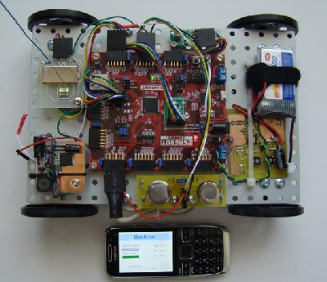
Outsourcing Decision
The circuit board has variable cost of £300 and allocated fixed overheads of £100.
If the circuit board can be bought it would cost the company £350.
Should the production of the circuit board be outsourced?
T

